Slide 1

MobileNets: Efficient Convolutional Neural Networks for Mobile Vision Applications
Project Submitted by
Gopi Palepu - 700759819
CS5720: Neural Network & Deep Learning
Under the Supervision of
Dr. Muhammad Zubair Khan
Professor

Slide 2
Motivation
Growing Demand for Mobile Vision Applications:
Increasing usage of smartphones and embedded devices for tasks like object detection, image classification, and augmented reality.
The need for real-time processing in applications such as video surveillance, autonomous driving, and personal assistants.
Limitations of Traditional CNNs: High computational and memory requirements.
Infeasibility of deploying large, power-hungry models on mobile devices with limited hardware capabilities.
Objective: Develop efficient models that can perform well on mobile and embedded devices without compromising too much on accuracy.

Slide 3
Problem Statement
High Computational Cost of Traditional CNNs:
Traditional CNNs, like VGG16, highlight the issue clearly. VGG16 has around 138 million parameters and requires about 15 billion FLOPs per forward pass, making it unsuitable for mobile devices.
Resource Constraints on Mobile Devices:
Mobile and embedded devices have limited CPU/GPU power and strict memory and storage limits. High computational demands also drain battery life, reducing the practicality of using advanced vision models on these devices for long periods.
Need for Lightweight and Efficient Networks:
The challenge is to design neural networks that balance accuracy and efficiency. This means reducing model size and computational complexity without compromising performance, enabling effective and efficient vision applications on mobile devices

Slide 4
Objectives
Design a Lightweight Architecture:
Utilize depthwise separable convolutions to reduce parameters and computational requirements.
Decouple spatial and depthwise convolutions to significantly cut down operations and parameters.
Introduce Scalability:
Incorporate width (α) and resolution (ρ) multipliers for adjustable network complexity.
Allow the network size and complexity to be scaled according to device requirements.
Achieve High Accuracy:
Maintain competitive performance on benchmarks like ImageNet.
Aim to balance accuracy and reduced computational costs.
Facilitate Real-time Processing:
Ensure efficient operation on mobile and embedded devices.
Enable real-time capabilities for applications like augmented reality and autonomous systems, where immediate processing is crucial

Slide 5
Contributions
MobileNets Architecture:
Depthwise Separable Convolutions: Reduces computation and model size.
Width Multiplier (α): Adjusts the number of channels, reducing parameters and computational cost proportionally.
Resolution Multiplier (ρ): Scales input image resolution to further lower computational cost by processing smaller images.
MobileNetV2: Introduced inverted residuals and linear bottlenecks for enhanced performance and efficiency.
MobileNetV3: Utilized Neural Architecture Search (NAS) for further optimization.
Added enhancements such as squeeze-and-excitation modules and swish activation functions.

Slide 6
Result
Model Size and Computation:
MobileNetV1: Significant reduction in parameters and FLOPs compared to traditional CNNs.
MobileNetV2: Improved efficiency with fewer parameters and lower computational cost.
MobileNetV3: Further optimized, providing the best trade-off between accuracy and efficiency.
Performance Metrics:
MobileNets perform competitively on ImageNet with significantly fewer parameters.
Example: MobileNetV2 achieves similar accuracy to ResNet-50 with far fewer parameters and FLOPs.
Real-world Deployment:
Successfully used in various applications like Google’s real-time image recognition on smartphones.
Implemented in edge devices for IoT applications.

Slide 7
Critical Analysis
Strengths:
Efficiency: Depthwise separable convolutions significantly reduce computational load.
Flexibility: Width and resolution multipliers allow for scalable architectures.
Real-world Applicability: Demonstrated success in mobile and embedded deployments.
Weaknesses:
Accuracy Trade-offs: While efficient, MobileNets may have lower accuracy than larger, more complex models.
Hardware Dependence: Optimal performance often requires specific hardware optimizations.
Future Directions:
Hybrid Architectures: Combining MobileNets with other lightweight models or techniques.
Advanced Training Techniques: Utilizing techniques like transfer learning, quantization, and pruning to further optimize performance.
Edge AI: Enhancing capabilities for edge devices with even stricter resource constraints.

Slide 8
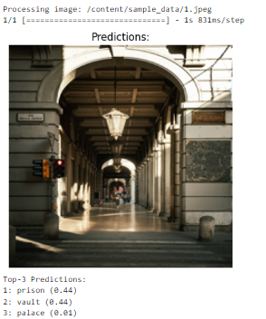
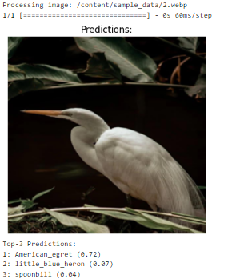
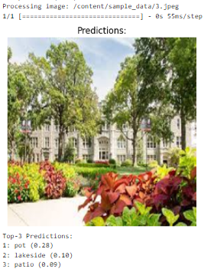
Results

Slide 9
References
Howard, A. G., Zhu, M., Chen, B., Kalenichenko, D., Wang, W., Weyand, T., Andreetto, M., & Adam, H. (2017, April 17). MobileNets: Efficient convolutional neural networks for Mobile Vision Applications. arXiv.org. https://arxiv.org/abs/1704.04861
Sandler, M., et al. "MobileNetV2: Inverted Residuals and Linear Bottlenecks." Proceedings of the IEEE Conference on Computer Vision and Pattern Recognition. 2018.
Howard, A., et al. "Searching for MobileNetV3." Proceedings of the IEEE International Conference on Computer Vision. 2019.

